Slide 1

ROCKBUSTER STEALTH LLC
JULY, 2023

Slide 2
INTRODUCTION
Rockbuster Stealth LLC is movie rental company transitioning to an online video rental service in order to stay competitive.
JULY, 2023
ROCKBUSTER STEALTH LLC

Slide 3
Key questions and objectives
Which movies contributed the most/least to revenue gain?
What was the average rental duration for all videos?
Which countries are Rockbuster customers based in?
Where are customers with a high lifetime value based?
Do sales figures vary between geographic regions?
JULY, 2023
ROCKBUSTER STEALTH LLC

Slide 4
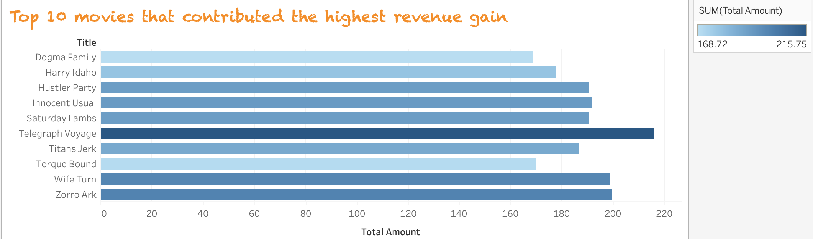
Q1.Which movies contributed the most to revenue gain?
JULY, 2023
ROCKBUSTER STEALTH LLC

Slide 5
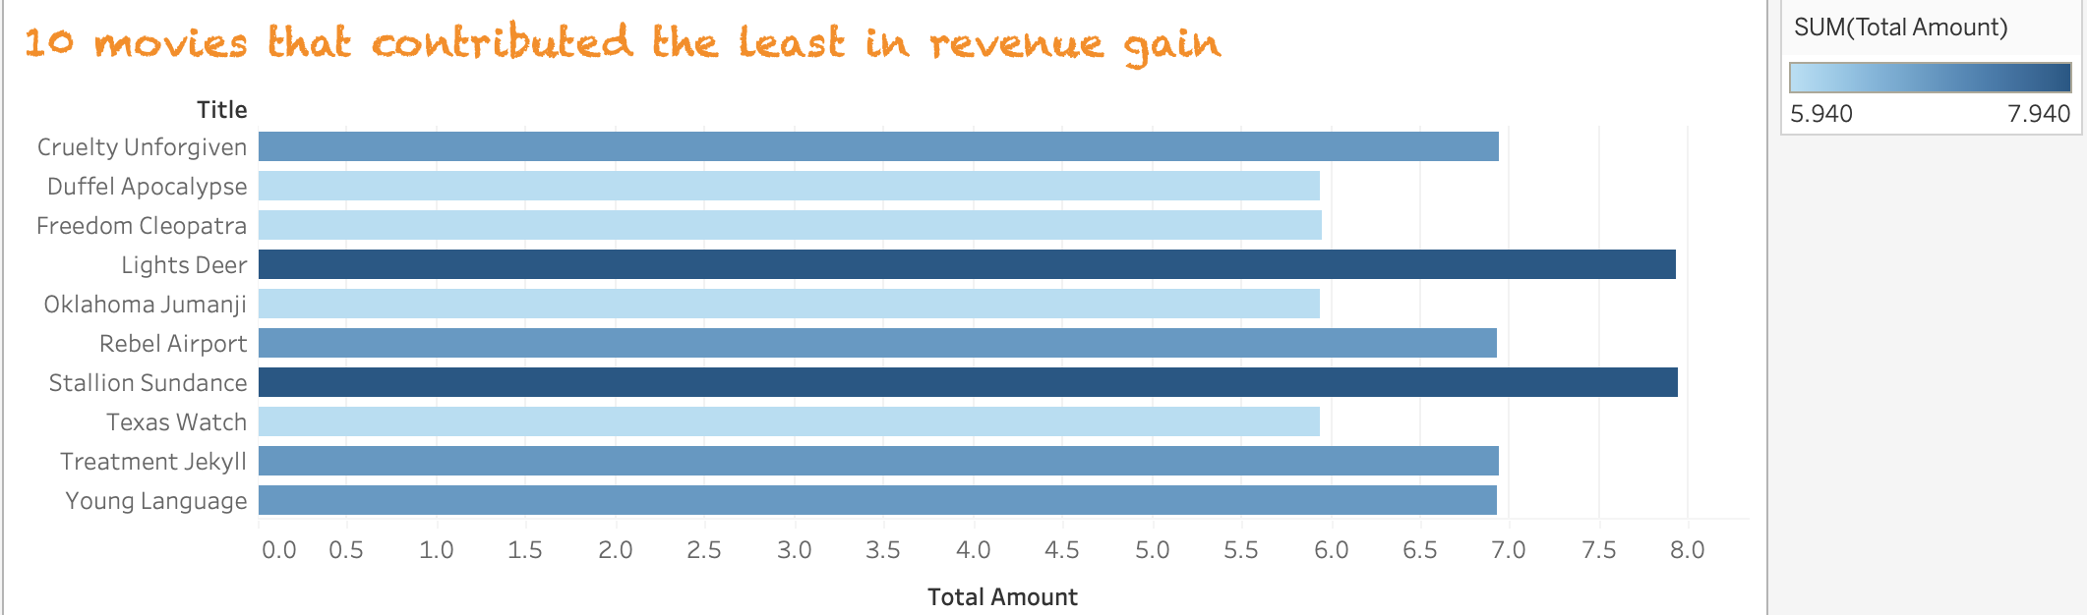
Q1.Which movies contributed the least to revenue gain?
JULY, 2023
ROCKBUSTER STEALTH LLC

Slide 6
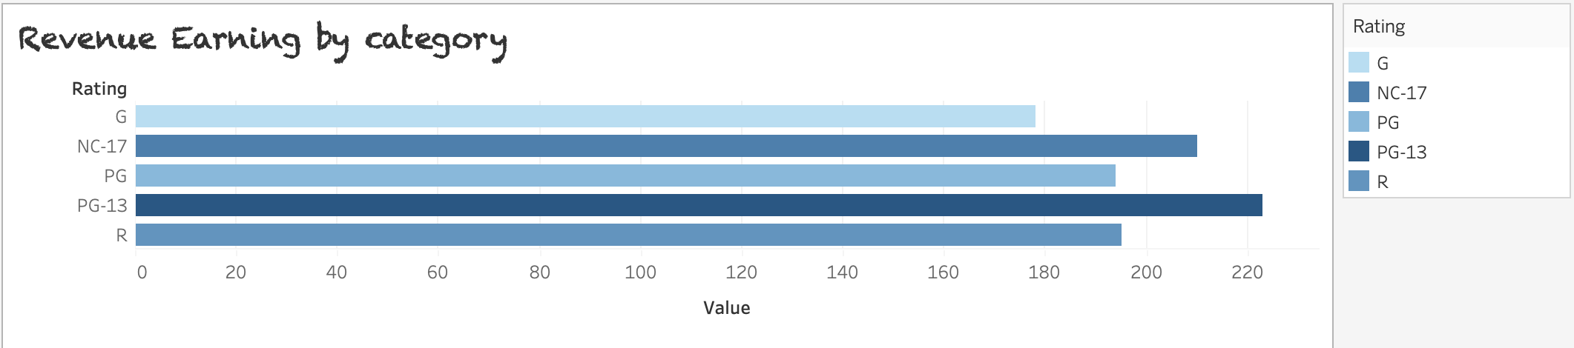
JULY, 2023
PG-13 is the top revenue-earning rating category followed by NC-17 and PG.
PG has the highest revenue per movie.
ROCKBUSTER STEALTH LLC

Slide 7
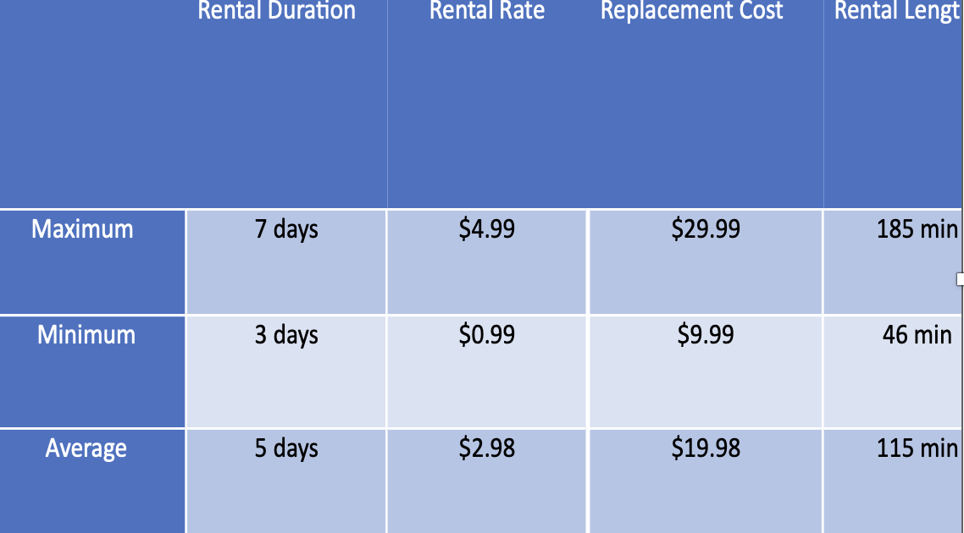
Q2. What was the average rental duration for all videos?
JULY, 2023
ROCKBUSTER STEALTH LLC
Average rental duration for all videos is 5 days

Slide 8
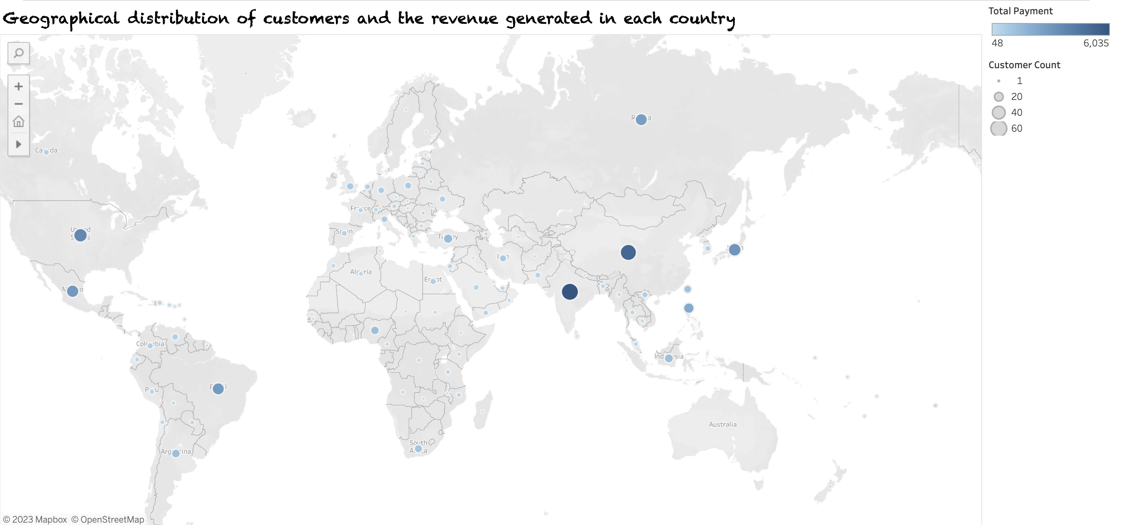
Q3. Which countries are Rockbuster customers based in?
JULY, 2023
India, China, United States, Japan and Mexico occur to be the top 5 with customers since they have high revenue generated.
ROCKBUSTER STEALTH LLC

Slide 9
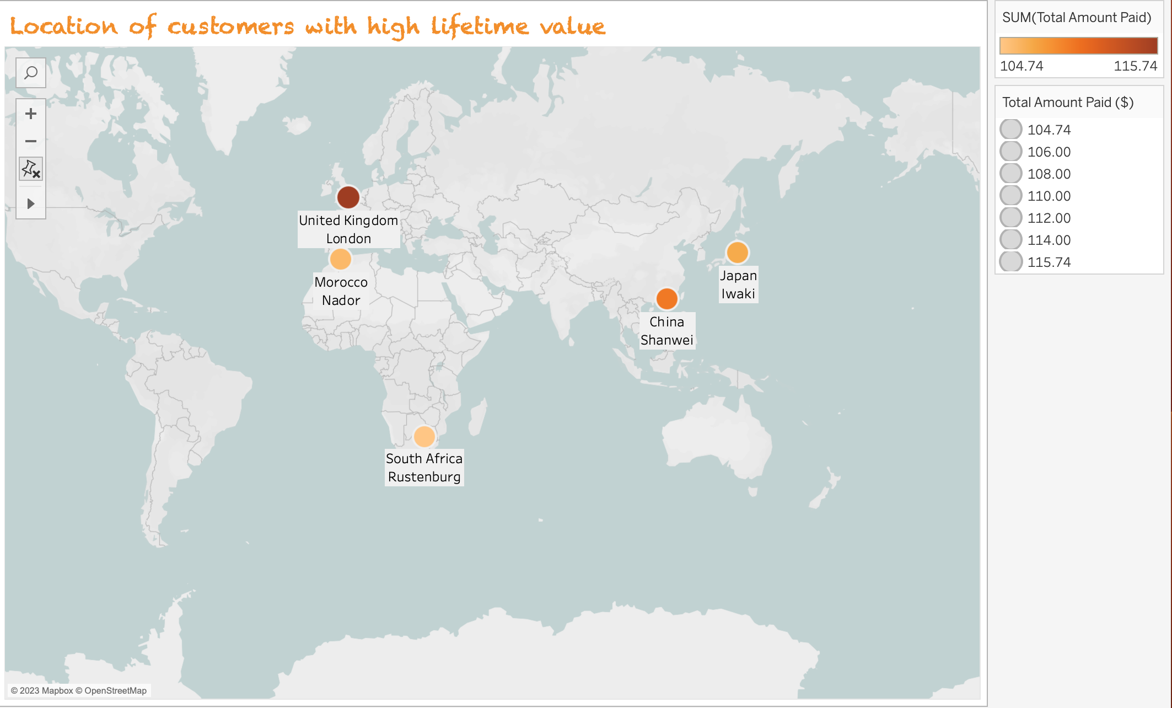
Q4. Where are customers with a high lifetime value based?
JULY, 2023
ROCKBUSTER STEALTH LLC

Slide 10
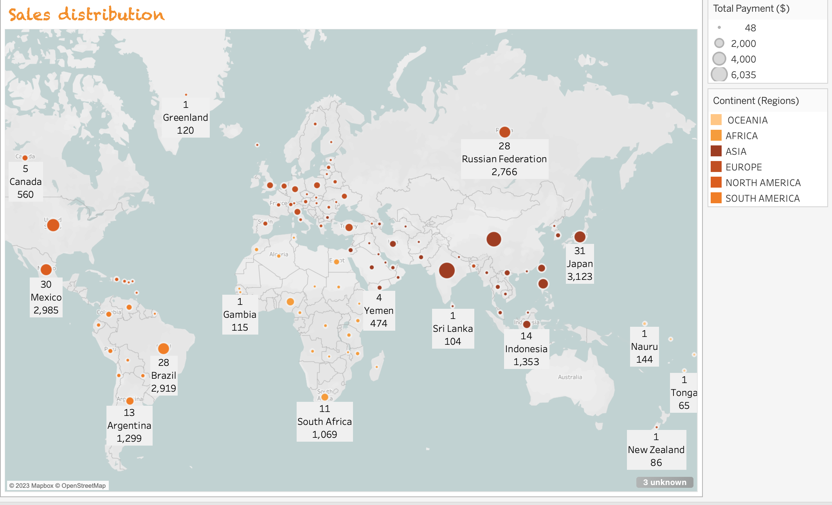
Q5. Do sales figures vary between geographic regions?
Sales figure vary with Asia, Europe and North America having the highest global revenue
JULY, 2023
ROCKBUSTER STEALTH LLC

Slide 11
RECOMMENDATIONS
Market should be focused on regions with high sales such as Asia, Europe and North American to boost revenue gain.
Also, market should be focused on countries like United Kingdom, India and China since they have more customers compared to any other countries and whereby top customers are located.
Also, given that average rental duration is 5 days, Max. 7 days and Min. 3 days, it would be advisable to extend the rental duration to a longer period so as to keep customers which might create good services.
JULY, 2023
ROCKBUSTER STEALTH LLC

Slide 12
ROCKBUSTER STEALTH LLC
THANK YOU
!!!
JULY, 2023

